Slide 1
Structural Equation Modeling with Patient Reported outcomes
Matthew Cox-Martin, PhD
April 13th, 2017

Slide 2
Context
For whom is this talk?
Advanced researchers with some statistical knowledge
Tips for getting the most out of this talk:
No equations
Try focus on the big picture
Ask questions related to your work

Slide 3
Outline
General overview of Structural Equation Modeling (SEM)
When you should use SEM
How you can use SEM
Pros of SEM
Cons of SEM
Software options

Slide 4
What is SEM?
A flexible framework for modeling data
Can be considered an extension of regression (GLM)
The full extent of SEM has not been fully explored
Three big advantages of SEM over regression
Can model implied causal structure
Can model multiple outcomes
Can model latent variables

Slide 5
Third Variable Analyses
Mediation
Moderation
M
b
a
X
c`
Y
X
Z
Y
X*Z

Slide 6
What is a latent variable?
Broadly
Any variable of interest that is unobserved
Depression, Health Related Quality of Life, Pain, Self-regulation, Self-efficacy, etc.
E.g., most patient reported outcomes
Specifically (within SEM)
An unobserved variable that is measured by 3 (sometimes 2) or more manifest/indicator variables
Also known as:
Construct
Factor

Slide 7
Example Model
Endogenous Variables
Mediating Variables
1
λ_{y31}
λ_{y21}
Exogenous Variable
Outcome Variable
ψ₂₁
Latent Variable
ε₁₁
ε₂₂
ε₃₃
Manifest/Indicator Variable
ψ₃₁
1
λ_{y52}
λ_{y62}
ψ₃₂
Covariance/
Correlation
ζ ₃
Regression path
1
λ_{y83}
λ_{y93}

Slide 8
Measurement Model
ζ ₁
1
λ_{y31}
λ_{y21}
ψ₂₁
Factor loading
(Regression path)
ε₁₁
ε₂₂
ε₃₃
ζ ₂
1
λ_{y52}
λ_{y62}
ψ₃₁
ψ₃₂
ζ ₃
1
λ_{y83}
λ_{y93}

Slide 9
Structural Model
γ₄₁
η₁
ψ₂₁
ξ₁
γ₂₁
η₂
β₄₂
η₄
δ ₁₁
X
1
1
Y
ε₁₀ ₁₀
ψ₃₂
ψ₃₁
η₃

Slide 10
Example Model
1
λ_{y31}
λ_{y21}
ψ₂₁
ε₁₁
ε₂₂
ε₃₃
1
λ_{y52}
λ_{y62}
ψ₃₂
ψ₃₁
ζ ₃
1
λ_{y83}
λ_{y93}

Slide 11
Conceptual model (Wilson, et al. 2016)

Slide 12
Analyzed model (Wilson, et al. 2016)

Slide 13
STEPS in conducting SEM
Specify Model
Conceptually lay out variables and their order
Identification of the model
Ensure you have enough degrees of freedom to estimate the model
Provide more information than parameters you are estimating
Estimate model
Analyze the specified model
Evaluate model fit
If fit is poor got back to step 1 and respecify
Interpret and report results

Slide 14
A Word of caution
This is an oversimplified explanation
Easy to conceptualize and explain results
Very complex estimation procedures
Ensure model assumptions are met
Linear relationships between variables
Known distribution of variables
No unmeasured confounding
Causality
Temporal precedence
Correctly specified causal order
Make sure your data analyst knows what they are doing

Slide 15
When can you use SEM
Any predictive modeling situation
Assuming you have the sample size
Exogenous and endogenous variables can be a mix of categorical and continuous

Slide 16
Examples
Multiple outcome variables
Any latent variables
Continuous latent variables = Confirmatory Factor Analysis (CFA)
Categorical/Dichotomous latent variables = Latent Class Analysis (LCA)/ Latent Profile Analysis (LPA)
Multi-trait Multi-method (MTMM)
Longitudinal Data
Latent Growth Curve Modeling (LGCM)
Growth Mixture Modeling (GMM)
Autoregressive model
Especially mediation models
Dynamic LCA/SEM for intensive longitudinal data
Models with implied causal structure

Slide 17
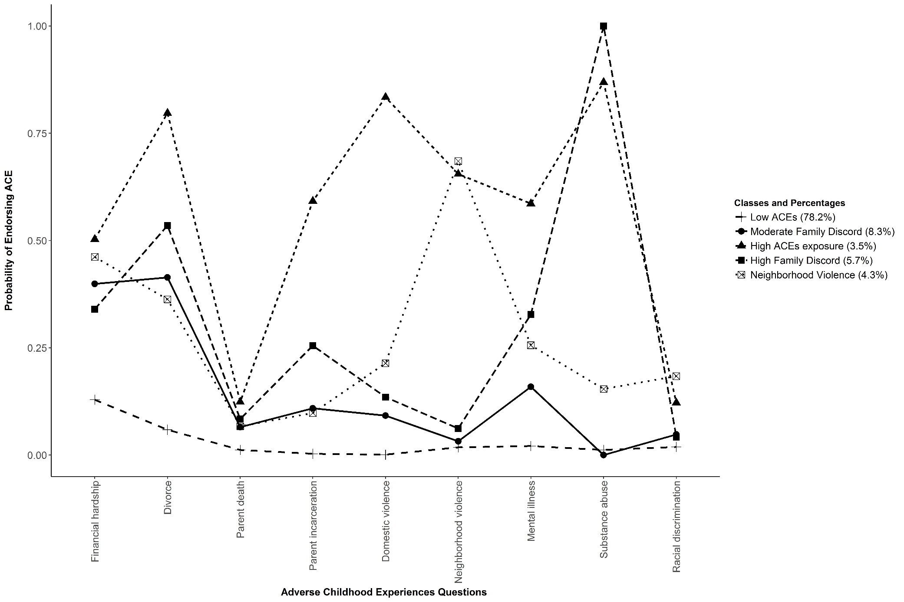
Latent Class Analysis (Stempel, et al. Under Review)

Slide 18
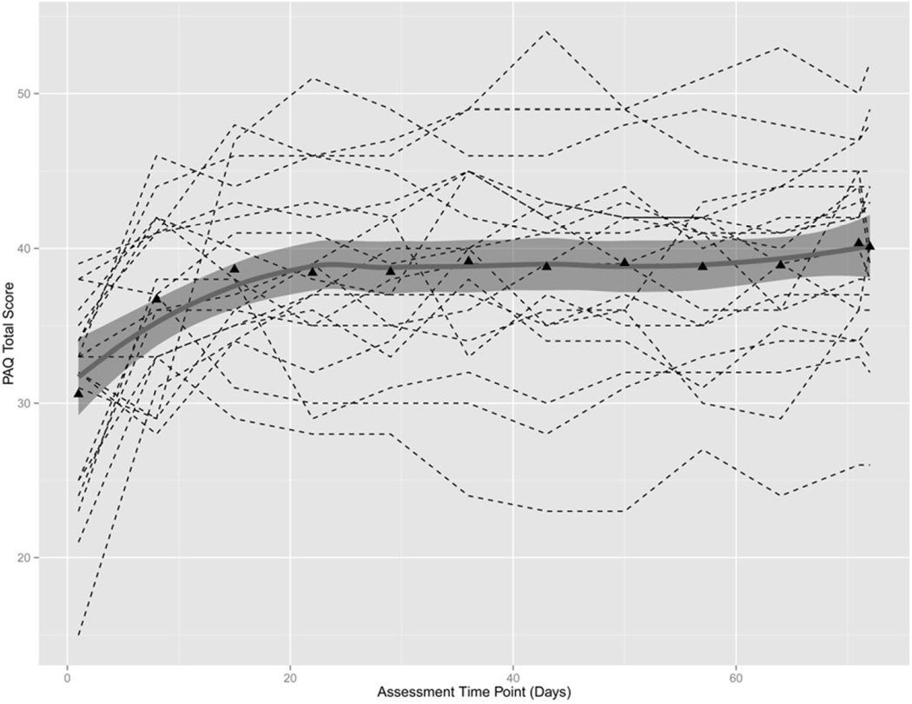
Growth Curve Modeling (Martin, et al. 2015)

Slide 19
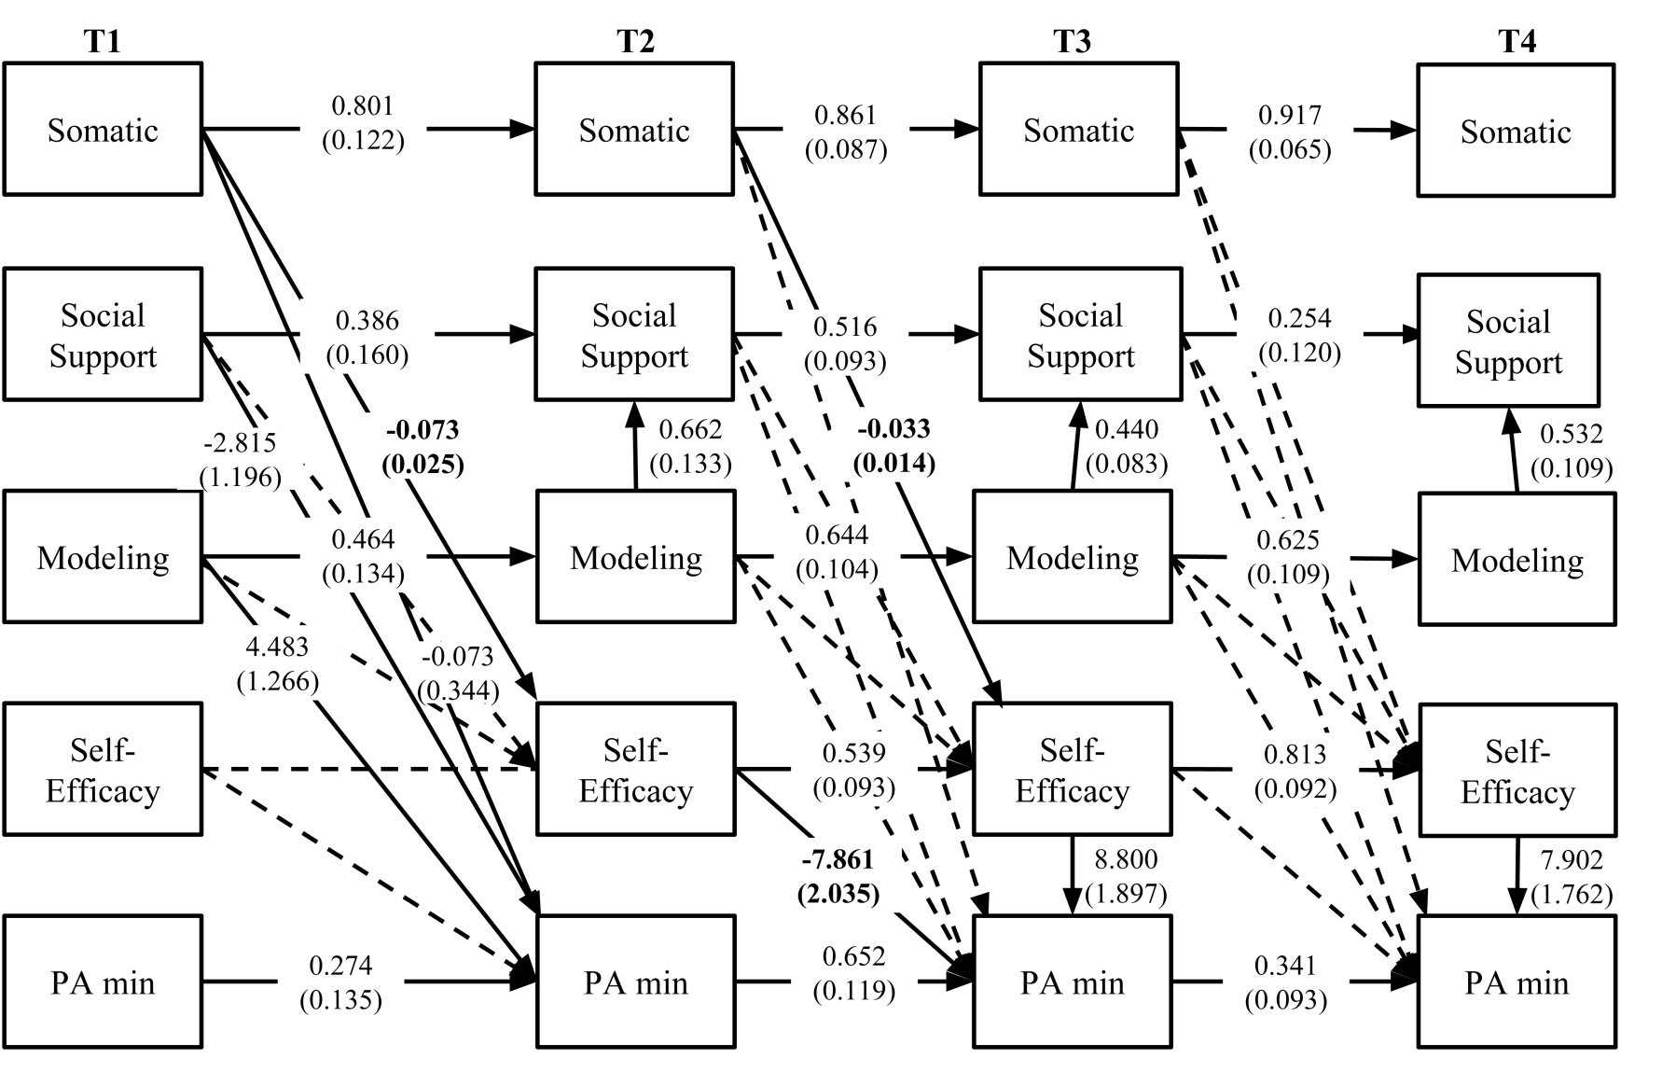
Autoregressive mediation Model (Cox, et al. 2015)

Slide 20
Pros of SEM
Highly flexible
Can handle almost any model in theory
Handles missing data through Full Information Maximum Likelihood
Great for longitudinal data
Has estimation procedures that are robust to violations of certain assumptions (i.e., normality)
Single best way to deal with measurement error for latent constructs
Measurement error can bias results
Some researchers have argued that all analyses with latent variables should be conducted in SEM

Slide 21
Cons of using SEM
Requires large sample sizes
200 or more (less for longitudinal data)
Estimating lots of parameters which decreases power
Power analyses are challenging
Have to be conducted via Monte Carlo simulation
SEM has traditionally been more confirmatory than exploratory
Sometime models don’t fit/converge
High potential for misinterpretation of causal structure

Slide 22
Psychometrics (i.e., my soapbox)
SEM is inextricably linked to psychometrics
Any time you have a measurement model you are conducting a Confirmatory Factor Analysis
Need to use validated measures
If model fit for the measurement model is inadequate, there’s no point moving forward
Exploratory Structural Equation Modeling (ESEM)
“Measurement is the soft underbelly of mediation” – David Mackinnon
SEM is not a panacea for bad measures
Measurement error can have deleterious and unpredictable effects in complicated causal models
Measurement error in the exogenous variables can underestimate results
Measurement error in mediators can lead to either over or under estimates results

Slide 23
Third Variable Analyses
Mediation
Moderation
M
b
a
X
c`
Y
X
Z
Y
X*Z

Slide 24
Software options
AMOS (via SPSS)
Can visually draw models
Mplus
Supper flexible with lots of great features
Fast reliable support
Costly
R options (all free)
Lavaan
OpenMx
SEM
Lisrel
Great way to learn SEM
Uses matrices so difficult to use practically
SAS
PROC CALIS

Slide 25
Example

Slide 26
Scaling latent variables
Latent variables don’t have any inherent scaling
Can scale variables one of two ways:
Fix one of the indicators to 1
Fix variance of latent variable to 1
Which one should you use?
Depends on what you are interested in
For CFA, I fix the variances
For SEM, I fix an indicator—usually the indicator with the highest loading

Slide 27
Number of indicators
Need at least 3 indicators to model a latent variable to have a “just identified model”
Just identified models are models with 0 degrees of freedom.
Degrees of freedom are calculated
More isn’t always better
Covariance among indicators of a specific latent variable can cause model fit to decrease
Can use a technical called parceling where you randomly average indicators together
Research says this is not a good approach
How many is too many?
It depends

Slide 28
Fit Indices
There are many
No consensus on which ones to use and what the cutoffs are for each
There are common fit indices with conventional cutoff values (i.e., people use them a lot)
Typically you want to choose three that don’t have overlapping shortcomings
Sample size dependent
Don’t take into account model complexity
Sensitive to model misspecification

Slide 29
Fit Indices (examples, c.f. Hu & Bentler, 1998)
Chi-square
Counterintuitively you want this to be nonsignificant
Null Hypothesis is that the estimated model is equal to the population model
Sample size dependent so large sample sizes will give you significant chi-square
Standardized Root Mean Square Residual (SRMR)
Smaller is better
.05 = good fit
.08 = adequate fit
Sensitive to model misspecification
Good for sample sizes ~ 250

Slide 30
Fit Indices (examples, c.f. Hu & Bentler, 1998)
Root Mean Square Error of Approximation
Smaller is better, with a lower limit of 0
.05 = good (I’ve seen people nudge this though)
Good for sample sizes ~ 250
Low sample sizes < 200 can inflate this value
Can get confidence intervals
Lower limit close to 0 and upper limit close to .08 for good fit
Can be used to estimate power in SEM models
Sensitive to model misspecification but NOT model complexity
Comparative Fit Index (CFI)
Higher is better with an upper limit of 1
.95 = good fit
Penalizes model complexity

Slide 31
Fit Indices (examples)
AIC and BIC can be used to compare non-nested models (for SEM)
They have no scale, but closer to zero is better (can be negative)

Slide 32
Model Estimation
Typically maximum likelihood (ML) is used
Produces fit indices
Somewhat robust to violations of normality
Some software (Mplus & R) use Full Information Maximum Likelihood to estimate missing data
Missing data is very common in survey research
Generally requires >= 200 observations

Slide 33
Model Estimation (cont.)
Other estimation methods are available for:
Non normally distributed continuous data (MLR)
Binary, count, or ordinal data (WLS, UWLS, DWLS)
Generally, software picks based on how you specify your data
This can lead to problems, so usually good practice to specify yourself

Slide 34
When to use SEM?
Whenever you have survey data and proper sample size
It’s the best way to deal with measurement error leading to the most unbiased estimates

Slide 35
THANKS!
Questions?

